Slide 1
Interest and Dividend Income
Pub 4012 – Tab D
Pub 4491 – Lesson 9
Notes:
Release 2 slide changes:
#26 – PAB interest now entered on 1099 screen
Minimal cosmetic changes
Comprehensive Slides placed at end of slide deck

Slide 2
Interest and Dividend Income
This lesson covers
Interest Income
US Savings Bonds and Treasury Obligation Interest
Tax exempt interest
Interest in a foreign bank account
Early withdrawal penalty
Impact on state return
Dividend Income
Ordinary dividends
Qualified dividends
Capital Gain dividends
Nondividend distribution
Dividend reinvestments

Slide 3
Interest Income
1099-INT and 1099-OID
Notes:
Release 2 Slide changes:
Added slide #6 – New 1099-OID TaxSlayer entry

Slide 4
Interest Income
Interest income accrues on
Bank and credit union deposits
Bonds
corporate or government
Loans
Interest is unearned income

Slide 5
Interest Income
Interest received from institutions reported on
Form 1099-INT
1099-OID
Report as regular interest
Out of scope if requires OID adjustment
Brokerage Statement
Schedule K-1
Notes:
Credit unions may call their interest “dividends” – it is interest and reported as such

Slide 6
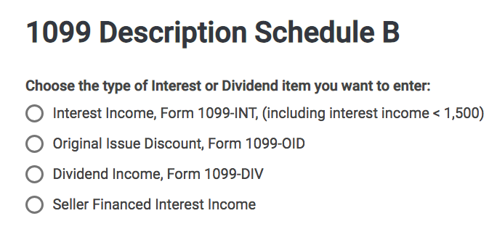
Interest Income
New TaxSlayer 1099-OID entry section

Slide 7
Interest Income
No form issued if interest received from
Seller financed mortgage interest income – see comprehensive topics at end of this lesson
Private or foreign payer
Interest less than $10
All interest must be entered on return
Even if no reporting document received
Including tax-exempt interest

Slide 8
Interest Income
All interest taxable except
State or municipal obligations
Other state municipal bonds may be taxable to state of residence
U.S. obligations: T-Bills, Savings Bonds, etc.
Taxable on federal return
Exception: Certain EE or I bonds used for education expense
Out of scope
Exempt on state return
Notes:
Informational:
Some treasury bonds may produce exempt interest for federal purposes
Certain “EE” or “I” bonds used for qualified education purposes
Requires Form 8815 – which is out of scope

Slide 9
Interest Income Early Withdrawal Penalty
Early withdrawal penalty adjustment
Penalty assessed on deferred interest account when funds withdrawn before maturity
Penalty subtracted from AGI as adjustment to income
Penalty located in box 2 1099-INT/DIV
Notes:
Early withdrawal penalty common with early withdrawal of CD

Slide 10
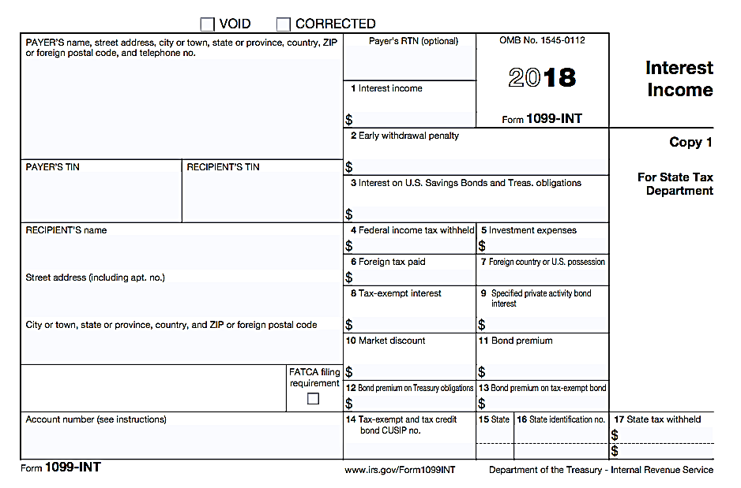
1099 – INT
OOS
OOS
FATCA is out of scope
Notes:
Report 1099-OID box 1 interest as you report regular interest
FATCA stands for Foreign Account Tax Compliance Act.
Box 5 Investment expenses. It is no longer a Schedule A deduction under the TCJA.

Slide 11
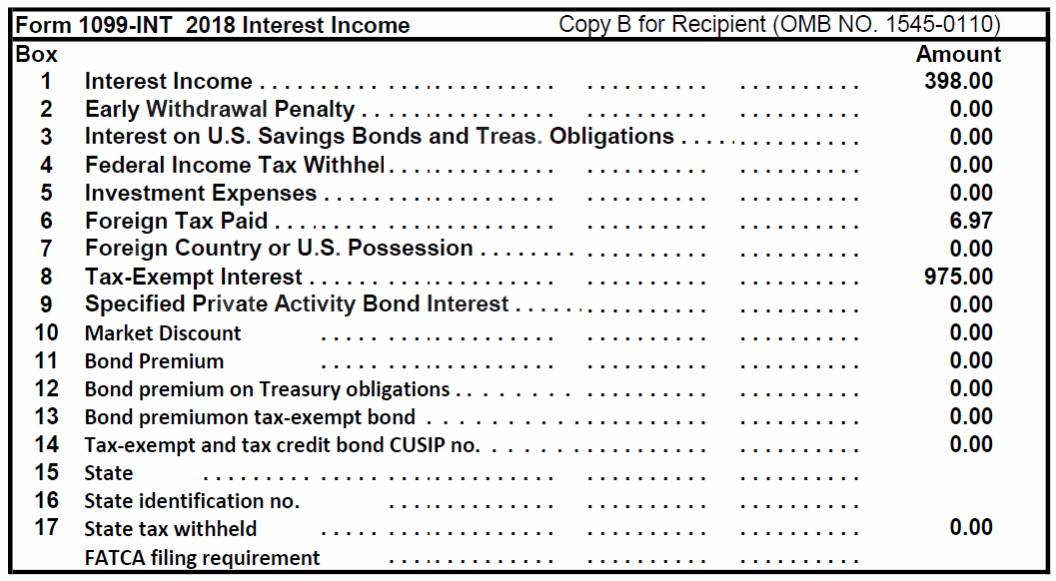
Interest Income – Sample Brokerage Statement
Lines 10-13 out of scope
FATCA filing requirement out of scope
Notes:
Emphasize:
All the information as in 1099-INT boxes
Lines 10-13 are out of scope
FATCA is out of scope
Format varies by payer
Examine all pages carefully- check to make sure you have all pages. Should say 1 of 12, 2 of 12, etc.

Slide 12
Bond Premium or Discount
Information only: Bonds purchased at a discount or with a premium are out of scope
Discount is additional interest income
Premium is reduction of interest income
Both amortized over life of bond
Accrued interest considered return of capital
Brokers report correct interest income on new purchases
Covered securities and in scope
Notes:
Informational
Discount is if bought at less than face value
Premium is if bought at more than face value
Emphasize
If taxpayer buys and sells bonds, they should be referred to a paid preparer
Premiums and Discounts are out of scope

Slide 13
Interview
Review Forms 1099-INT and 1099-OID for scope
Market discounts
Bond premium
FATCA filing requirement

Slide 14
Interest Income Quiz
Is the following interest taxable on a federal return?
New York City bond interest
Treasury bill interest
Ford Motor Co bond interest
Interest on loan to cousin Charlie
No
Yes
Yes
Yes

Slide 15
Dividend Income
1099-DIV

Slide 16
Dividend Income
Dividend income reported on
Form 1099-DIV
Brokerage or mutual fund statements (substitute 1099-DIV)
Schedule K-1
Notes:
Emphasize
Many taxpayers have direct investments, not held in a brokerage account
Probing questions and extra care are needed to make sure all are accounted for

Slide 17
Dividend Income
Dividends are paid out of earnings and profits from corporations
Dividends paid to equity shareholders
“Total ordinary dividends” includes two subsets
Qualified dividends
199A dividends

Slide 18
Dividend Income
Ordinary dividends that are not qualified
Taxed at marginal tax rate
Qualified dividend subset
Qualify for lower capital gain tax rate
199A dividend subset
Qualify for qualified business income (QBI) deduction – see Standard Deduction lesson
Notes:
Emphasize
Capital gains may be taxed at a lower rate than ordinary income
Rate can be as low as zero

Slide 19
Dividend Income
Capital gain dividends
Paid by mutual funds and Real Estate Investment Trusts (REITs)
Qualify for lower capital gain tax rate regardless of how long shares held
Out of scope
Section 1202 gain (box 2c)
28% gain out of scope (box 2d)
Liquidation distributions (boxes 9 and 10)

Slide 20
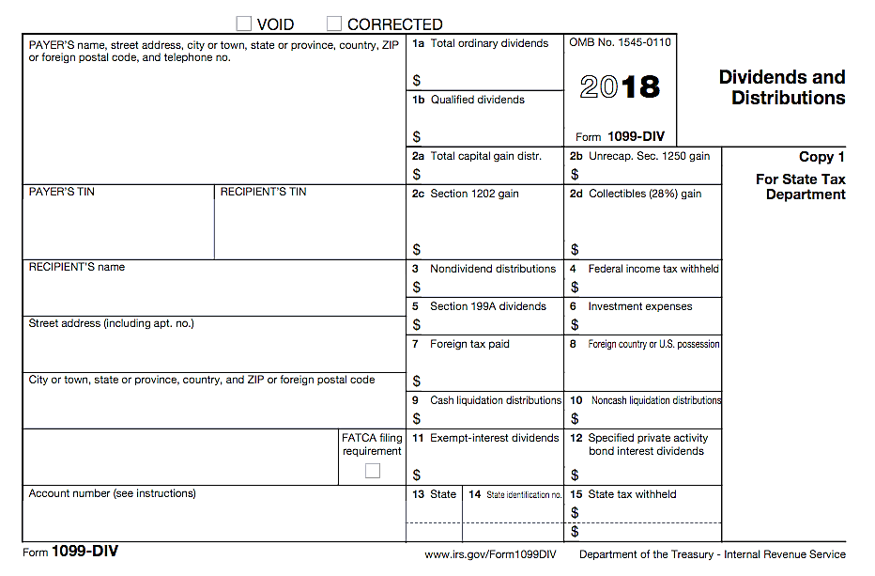
1099-DIV
Box 5 Section 199A dividends
OOS
OOS
OOS
OOS
FATCA Out of Scope

Slide 21
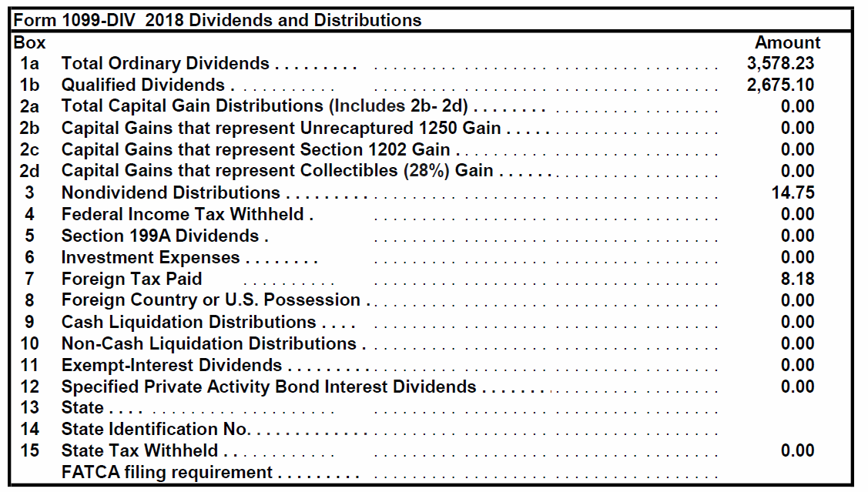
1099-DIV Brokerage Statement
Lines 2c – 2d Out of Scope
Lines 9 and 10 Out of Scope
FATCA filing requirement
Out of Scope
Notes:
Emphasize
Same as boxes on 1099-DIV
Box 2c Sec 1202 gains – out of scope
Boxes 9 and 10 Liquidation distributions – out of scope
FATCA filing requirement - out of scope
Look out for state withholding

Slide 22
Dividend Income
Nondividend distributions
Nontaxable distribution
Postponed until stock sold
Return of capital
Basis reduced by nontaxable dividend amount
Covered security – payer keeps track of basis
Non-covered security – taxpayer must adjust basis of investment
Notes:
Definition of “covered securities” generally
Stock purchased in 2011 and later
Mutual fund shares purchased in 2012 and later
Other securities (options, bonds, etc.) have later “covered” dates
TaxSlayer has a place to enter nondividend distribution, but doesn’t affect return

Slide 23
Dividend Income
Reinvested dividends are taxable
Dividends taxed and new shares purchased
Taxable amount becomes basis of new shares purchased
Covered security – payer adjusts basis
Non-covered security – taxpayer must adjust basis of investment

Slide 24
Net Investment Income Tax
Net Investment Income Tax (NIIT) out of scope
3.8% net investment tax on lesser of net investment income or amount MAGI exceeds
$250,000 MFJ and QW
$200,000 S and HoH
$125,000 MFS
Notes:
In general, investment income includes, but is not limited to:
interest, dividends, capital gains,
rental and royalty income,
non-qualified annuities,
income from businesses involved in trading of financial instruments or commodities (OOS), and
businesses that are passive activities to the taxpayer (OOS)
The tax applies on the lesser of net investment income or the amount by which AGI exceeds the thresholds above

Slide 25
Interest or Dividend State Tax Withheld
To enter state tax withheld 1099-INT/DIV
Search “state withholding” and select
or
Go to Payments and Estimates Screen
Carries to Schedule A and State Returns
Can add more state withholding entries
Don’t duplicate state tax from W-2, 1099-R or 1099G
Notes:
Class can find a “Note” at the bottom of Pub 4012 Interest Income (continued) page

Slide 26
Private Activity Bond Interest
Pub 4012 Tab D
When private activity bond (PAB) interest entered on 1099-INT/DIV
Can now be entered on the 1099-INT or -DIV entry screen
May generate alternative minimum tax (AMT)
If AMT applies return is out of scope
Notes:
If any PAB entry, need to check AMT (1040 line 45) – IF >0 OUT OF SCOPE
Under Section 103(a) of the Internal Revenue Code (IRC), interest on private activity bonds is not excluded from gross income unless the bond is a qualified bond. Interest from private activity bonds became subject to the Alternative Minimum Tax (AMT) after the Tax Reform Act of 1986, with the exception of hospital and non-profit college bonds. All things equal, yields on private activity bonds are higher due to this tax treatment.
According to Section 141 of the IRC, a municipal bond will be deemed a private activity bond if more than 10% of the proceeds from the bond issue are used for any private business, and the principal and interest payment on more than 10% of the sale proceeds of the issue is secured by a private business property. Secondly, a municipal bond will be classified as a private activity bond if the amount of proceeds of the issue used to make loans to non-governmental borrowers exceeds 5 percent of the proceeds or $5 million, whichever is less.

Slide 27
Quality Review Interest and Dividend Income
Review Intake Booklet for interest or dividends
Verify interest or dividend income entered correctly
Including interest or dividend received without paperwork
Review for state adjustments

Slide 28
Quality Review Interest and Dividend Income
Compare to prior year
Missing accounts
Foreign tax credit or deduction
Review for any missing interest or dividends

Slide 29
Dividend Income Quiz
True or False?
Dividends reinvested in additional shares are not taxable
False – reinvested dividends are taxable
Notes:
Emphasize
Whether or not reported on a 1099, taxpayer must report all their income

Slide 30
Dividend Income Quiz
True or False?
Payers of dividends less than $10 don’t have to issue 1099
True – same rule as for interest payers
Taxpayers are not required to report dividends if they do not receive Form 1099-DIV
False – all income must be reported on the tax return
Notes:
Emphasize
Whether or not reported on a 1099, taxpayer must report all their income

Slide 31
Comprehensive Topics
Interest and Dividends
Notes:
These topics are marked comprehensive because they are rarely encountered
All Counselors should be aware of the topics
Experienced Counselors should be well versed in these topics and how to look up guidance in Pub 4012
Seller financed mortgage intesest
Foreign accounts

Slide 32
Seller-financed Mortgage Interest
Taxpayers receiving interest from seller-financed mortgage must report interest income
Return must include buyer’s name, address, and SSN
Find Seller Financed Mortgage Interest in Volunteer Resource Guide (Pub 4012) Tab D for TaxSlayer entries

Slide 33
Foreign Account or Foreign Trusts
Taxpayers with interest or signature authority in foreign bank accounts must disclose
Taxpayers with foreign trusts must disclose
Beneficiary, grantor or transferor
Does not matter whether current income or not – must report the account
Refer to paid preparer
Notes:
Schedule B Questions
Read questions carefully –
Check here if at any time during this tax year, you had an interest in or a signature or other authority over a financial account in a foreign country, such as a bank account, securities account, or other financial account.
Check here if you are required to file Form FinCEN 114 to report that financial interest or signature authority and select the name of the country below.
Check here if at any time during the tax year you received a distribution from, or were the grantor of, or transferor to, a foreign trust.

Slide 34
Foreign Accounts or Specified Financial Assets
Special Note
If any FATCA box is checked or if taxpayer has foreign accounts or financial assets $50,000 or more
Advise taxpayer of substantial penalties for not filing the required forms
Refer taxpayer to paid preparer
Notes:
See form 8938 instructions for the definition of a specified foreign financial asset – it is not limited to bank or brokerage accounts.

Slide 35
Interest and Dividend Income
Comments
Questions

